Slide 1


Exploratory Data Analysis Project

Slide 2

INTRODUCTION
Project Overview
Project Background
Primary Goal
Exploratory Data Analysis for Northwind's digital store operations, focused on generating actionable insights to improve profitability.
Analyze business operations and customer behavior to identify opportunities for revenue growth and operational excellence.

Slide 3
COMPANY PROFILE
About Northwind
Northwind is a wholesale distributor specializing in food and beverage importation and exportation from around the world.
Product Sourcing
Inventory Management
Sources products through various suppliers across specific categories including beverages, produce, and packaged items.
Tracks stock levels and restocking through it's systems that stores the data on Products dataset.
Customer Relations
Order Fulfillment
Maintains ordering data showing purchase frequency and order specifics for each customer.
Documents complete order process from placement through shipping and delivery.

Slide 4




Profit Generation Model
Wholesale Pricing
Buy products at wholesale prices from suppliers
Margin Creation
Sell at higher prices to create gross profit margin
Volume Strategy
Leverage high-volume bulk sales to drive revenue

Slide 5

KEY METRICS
Research Motivation
Northwind’s mission is to provide quality products efficiently and to build strong relationships with its clients, ensuring they receive what they need when they need it. Moreover, Northwind Business Idea is to gain revenue through gross profit leveraging high volumes to drive revenue.
01- Quality
02- Efficiency
03- Customer Relationship
Repeat Purchase Rate
OTIF Delivery
Customer Concentration
Measures product quality and customer relationship strength through repeat purchasing behavior
On-Time & In-Full delivery reflects operational efficiency and reliability
Identifies most profitable customers to optimize relationship efforts
04- Gross Profit
05- High Volumes
Gross Profit
Average Order Value
Analyzes profit sources and cost factors for growth opportunities
Studies order volume trends to increase transaction sizes
Notes:
להתרכז על הקשר בין המשימה לבין הKPI שלקחתי

Slide 6

Research Questions
Primary Question
How can Northwind increase its profit using data-driven decisions?
Supporting Questions
Which products have low repeat purchase rates?
Where can operations be optimized for efficiency?
Who are the most profitable customers and their profiles?
How can gross profit be increased?
What factors affect Average Order Value?

Slide 7
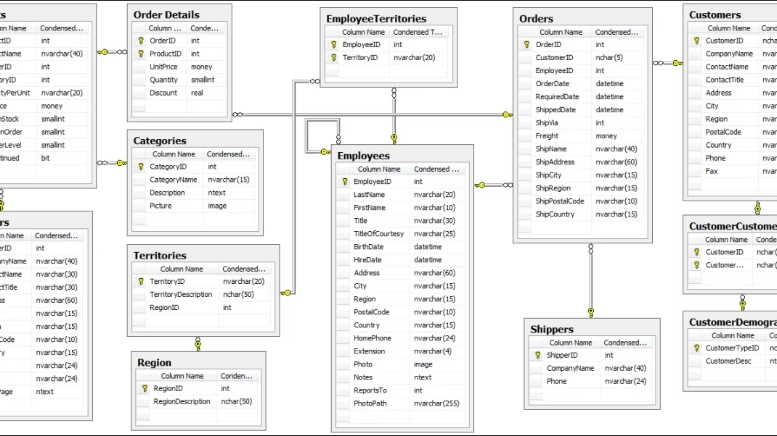
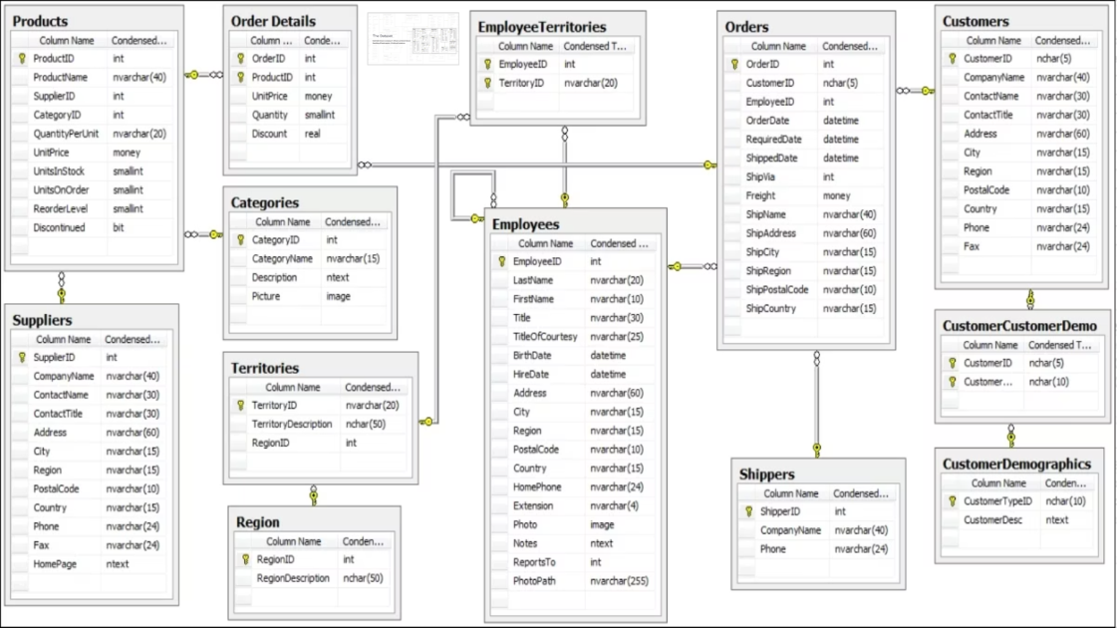

The Dataset
Multi-label dataset containing 11 different and related dataset describing different aspects of Northwind operations.
Notes:
להכנס לדטה סט, קצת לדבר על הטבלאות שעבדתי ועל הקשרים שלהן

Slide 8
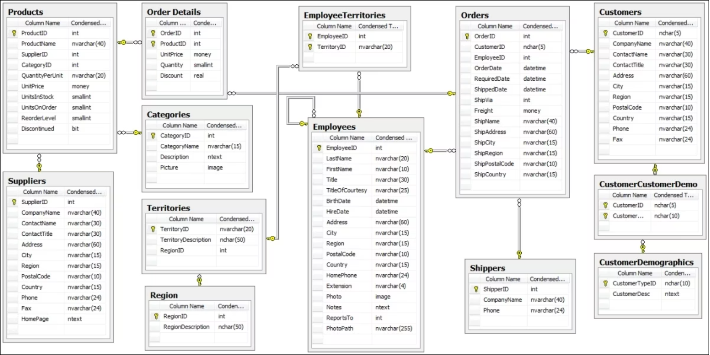
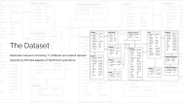
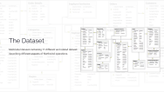
The Dataset
Multi-label dataset containing 11 different and related dataset describing different aspects of Northwind operations.

Slide 9

METHODOLOGY
Data Cleaning & Preprocessing
1
Missing Values
Identified and handled null values to ensure data completeness
2
Data Types
Corrected data types for accurate analysis
3
Outlier Treatment
Analyzed and addressed outliers appropriately
4
Variable Restructuring
Renamed and restructured for clarity while preserving data integrity
Notes:
לתת 2 דוגמאות:
לצורך מחקר זמני משלוחים, מחקתי הזמנות שלא הגיעו ליעד עדיין בזמן הוצאת הנתונים
סידור כותרות של עמודות SHIPVIA ו- UNITPRICE כדי לשקף את המשמעות שלהן
חריגים- לא הסרתי, עבדתי וניתחתי אותם

Slide 10

METHODOLOGY
Analysis Techniques
Descriptive Statistics
Calculated mean, median, and variance to understand central tendencies and data spread.
Distribution Analysis
Examined the spread and shape of key variables to identify patterns and outliers.
Correlation Analysis
Identified relationships between numerical features using regression techniques.
Categorical Comparisons
Compared data across different groups to reveal distinct behavioral insights.
Visual Exploration
Utilized histograms, box plots, and scatter plots for intuitive data representation.
Insights from initial analyses informed subsequent, deeper data explorations.

Slide 11
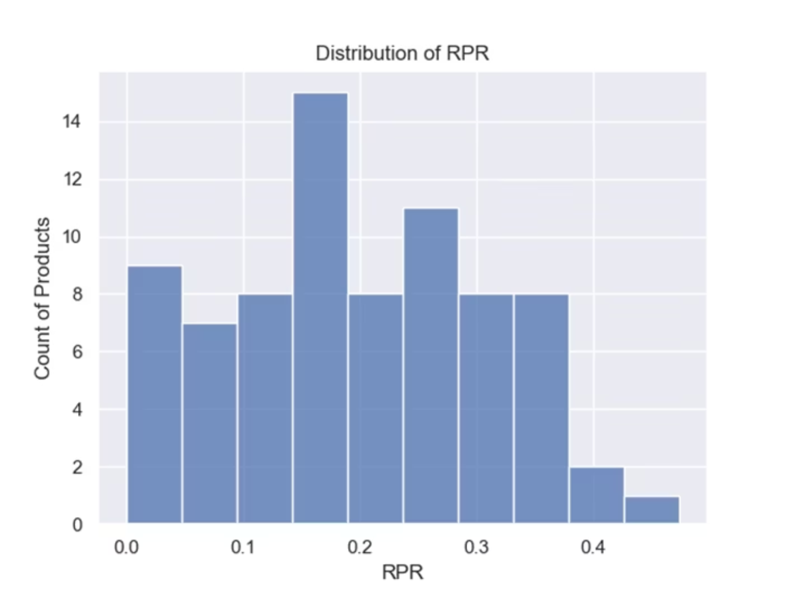
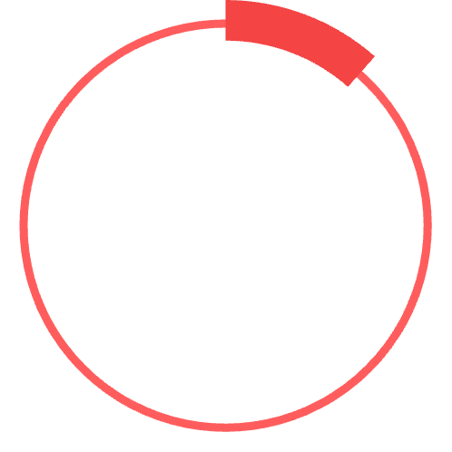


FINDING 1
Low Repeat Purchase Rate
RPR calculated as ratio of customers purchasing a product more than once to total unique customers.
11.5%
100%
Products with 0 PRR
Products at low/concerning RPR
Recommendation : commit a comprehensive audit of customer’s satisfactiona quality assessment of company's products.
Notes:
הצגת הטווחים
קישור לגרף
11.5% מהפריטים לא הוזמנו שוב כלל
המלצה

Slide 12
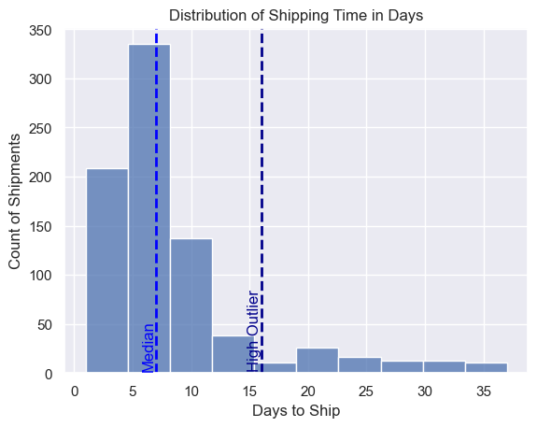
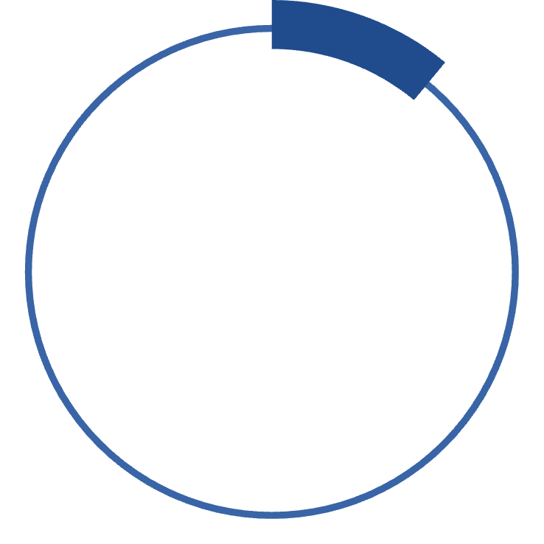


FINDING 2
Shipping Optimization Needed
11%
95%
Outliers
OTIF Rate
By Shipping Time
Good competitive delivery performance
Local US shipments take as long or longer than intercontinental shipping.
Heat map analysis reveals problematic areas: Ireland, Spain, UK that require investigation
The percentage of outliers shows inconsistency and warns of potential OTIF failures
Notes:
פיזור מוטה של זמני המשלוח – תקין בנוסף ל95% OTIF
כדי להבין טוב יותר את ה5% האחרים, צריך להבין את החריגים שמהווים 11% מההזמנות – נורת אזהרה
קורלציה של 2 ערכים – להכנס לקליק האמצעי
פער במשלוח מקומי- סכנה מול המתחרים

Slide 13
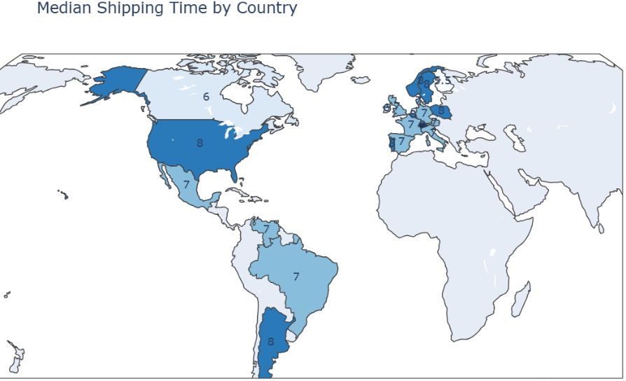


Slide 14
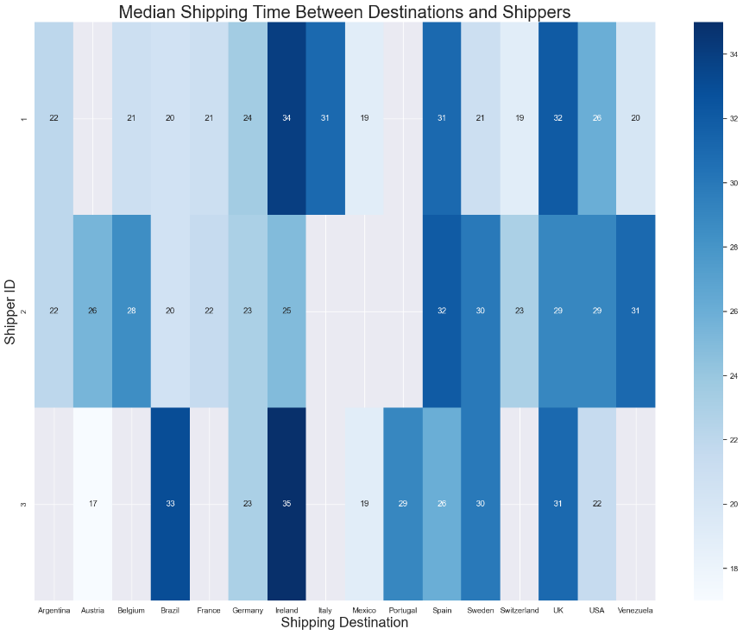

Slide 15
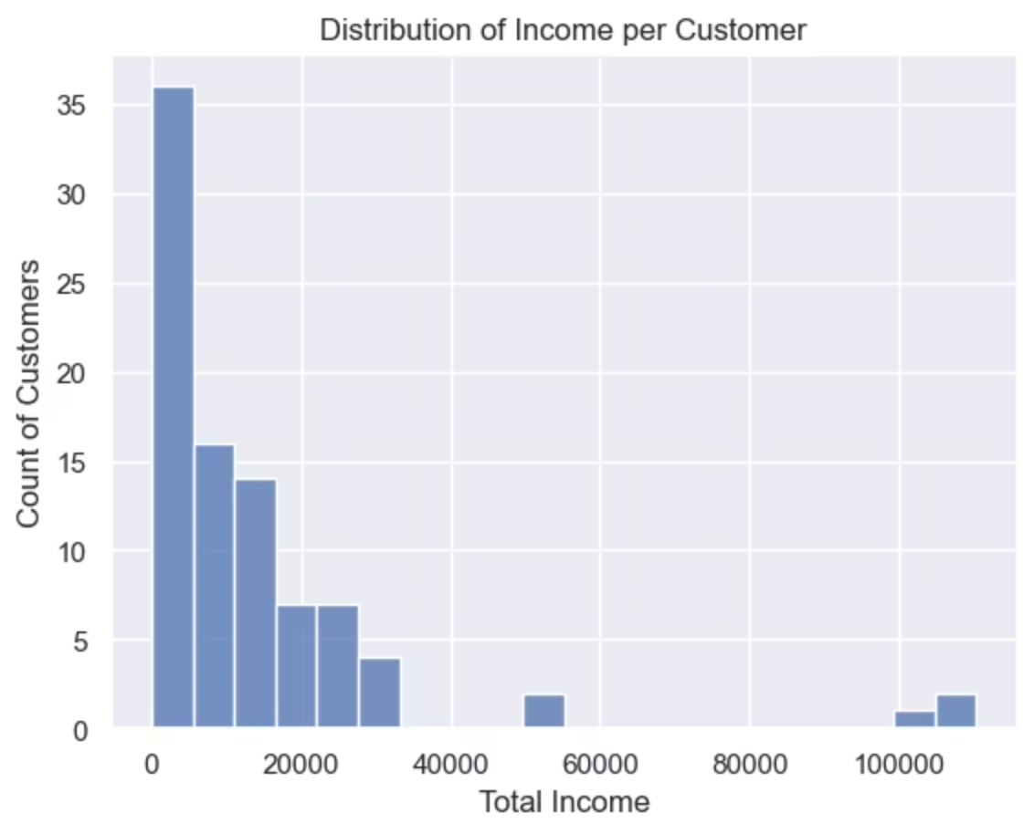
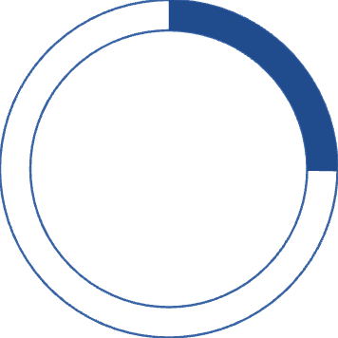

FINDING 3
Customer Concentration Risk
25.24%
CCR Rate
Customer Concentration Ratio shows concerning dependency
Target Markets for Growth
Austria: Leverage Ernest Handel partnership success
France/Brazil: Medium influence markets with growth potential
Recommendations
Allocate resources for personalized solutions to leading customers
Expand high-income customer base to balance risk exposure
Notes:
יחס CCR עבר את רף המדאיג ומתחיל להיות ריכוזי
3 חברות מחזיקות 25% מרווחי החברה בפער אדיר.
הגדלת החשיפה לשווקים נבחרים- להכנס לקליק

Slide 16
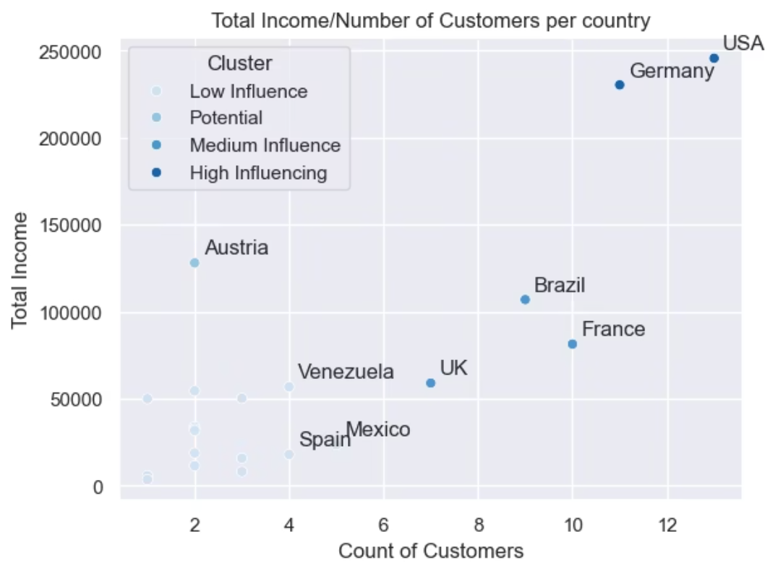

Slide 17
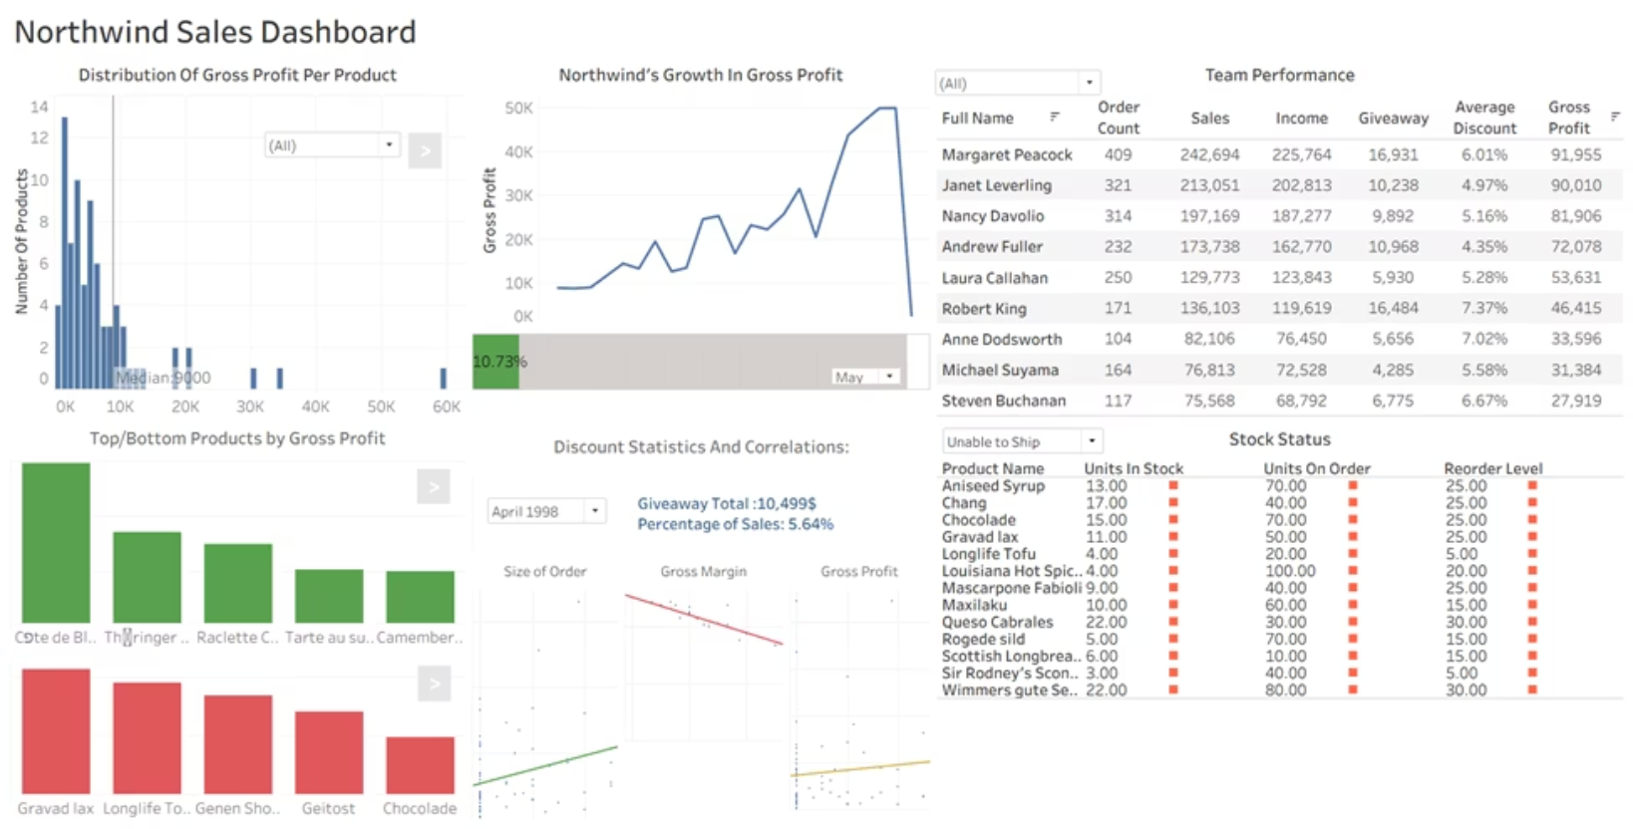
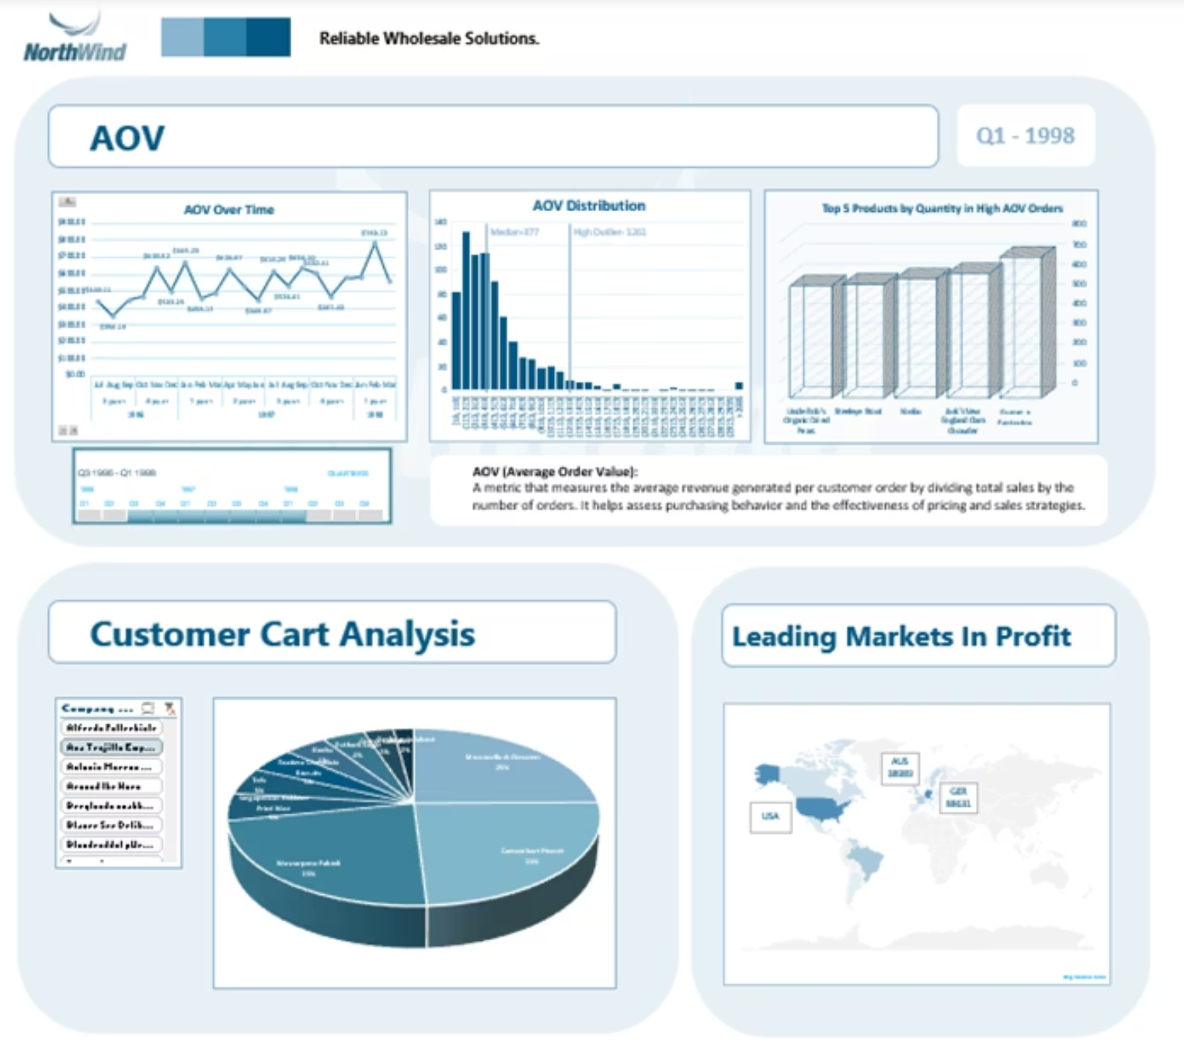
Other Delivarbles
Tableau Interactive Dashboard
Audience: Sales team managers
Key Features: Monthly gross profit gauge, Team performance, Stock status, Trending Items
Excel Interactive Dashboard
Audience: Customer relations team
Key Features: AOV KPI, Customer Behaviour
EDA Rerport
Full analysis and explanation of the dataset, key insights, analysis approach, etc.
Notes:
לעבור בין הדשבורדים ולהציג יכולות וממצאים

Slide 18

FUTURE WORK
Next Steps for Enhanced Profitability
Statistical Hypothesis Testing
Conduct rigorous testing to validate assumptions and quantify impact of key variables on profit.
Feature Engineering & Modeling
Develop new features and predictive models to forecast sales, identify trends, and optimize inventory.
Expand Data Sources
Integrate additional data on shipping variables (delays, weather) and deepen customer profile insights.
Advanced Analytical Techniques
Apply sophisticated methods to uncover root causes of shipment delays and other operational inefficiencies.

Slide 19





Work Process And Tools
1
2
3
4
SQL
Pyton
Excel / Tableau
AI Tools
Data Extraction
Data Cleaning And Analysis
Data Analysis And Dashboard Creation
Gemini - Insperation, Code Guidance
pandas, numpy, matplotlib, seaborn, plotly, statsmodels
ChatGPT - Proofreading, Text Structure
Gamma - Presentation

